Slide 1
Skin Cancer Diagnosis using Deep Learning
Shahad Aati - Morooj Aldeeb

Slide 2
Introduction
Using Deep Learning technology to classify patients’ dermatoscopic images to diagnose and distinguish skin cancer from other types of non-malignant skin lesions….

Slide 3
objective
Distinguish skin cancer lesions from other types of skin lesions with high accuracy and precision.

Slide 4
Classification Approach
We used binary classification (2 classes) to distinguish between Skin Cancer and Non-Cancer lesions.
We also used another multi-class classification (7 classes) different skin lesions from each others including skin cancer lesions.

Slide 5
METHODOLOGY
01
Preprocessing
02
Image Augmentation
03
Convoluted NN
04
Transfer Learning
Rescaling , Resizing, Zoom and Rotating
Batch Normalization , Pool Size , Filters
Using different CNN architectures to classify skin lesions.
Using different pretrained models with Complex MLP

Slide 6
Image Preprocessing
1/255
20%
(64,64,3)
Rescaling
Zoom
Resize

Slide 7
Data Description
From Kaggle
10016 data instances
( dermatoscopic images)

Slide 8
Tools and Libraries

Slide 9
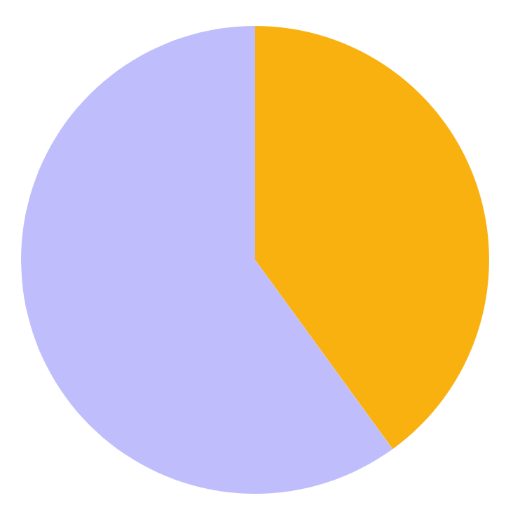
Data Division
20%
80%
Training Data Set
Validation And Test Data Set

Slide 10
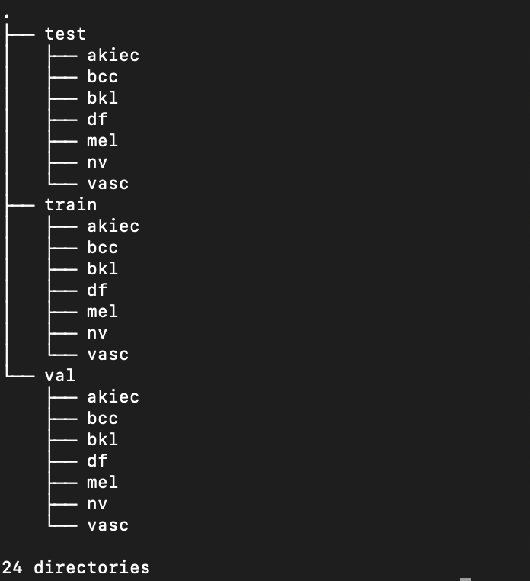
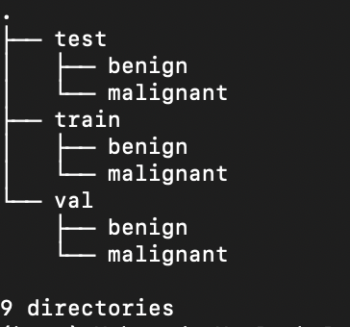
Folders Structure

Slide 11
Pipeline
Image Data Generator And Image Augmentation
Data Split
Training and Validation
Test (NN, CNN)
data splitting
data splitting
data splitting
data splitting
data splitting
1
2
(6490) images Train
(180) images Validation
(1002) images Test belonging to 2 classes.
Lazy Image Loading
3
4
Utilized different sizes of NN and CNN networks
Different Models
5
Transfer Learning

Slide 12
Image Samples(Cancerous)
Mel ( Melanoma ) | Bcc (Basal Cell Carcinoma) | Akiec (Actinic Keratosis)

Slide 13
Image Samples(Non-Cancerous)
Df (Dermatofibrom) | nv (Melanocyte nevi ) | Vasc (Non-Cancer Vascular Lesions) | Bkl (Sebohrreic keratosis)

Slide 14
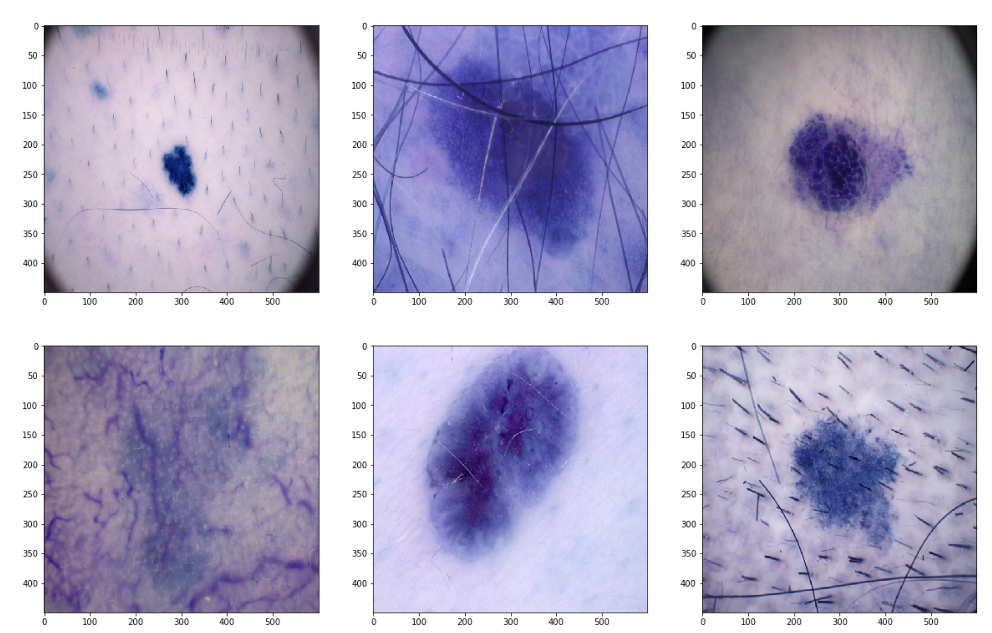
Image Samples

Slide 15
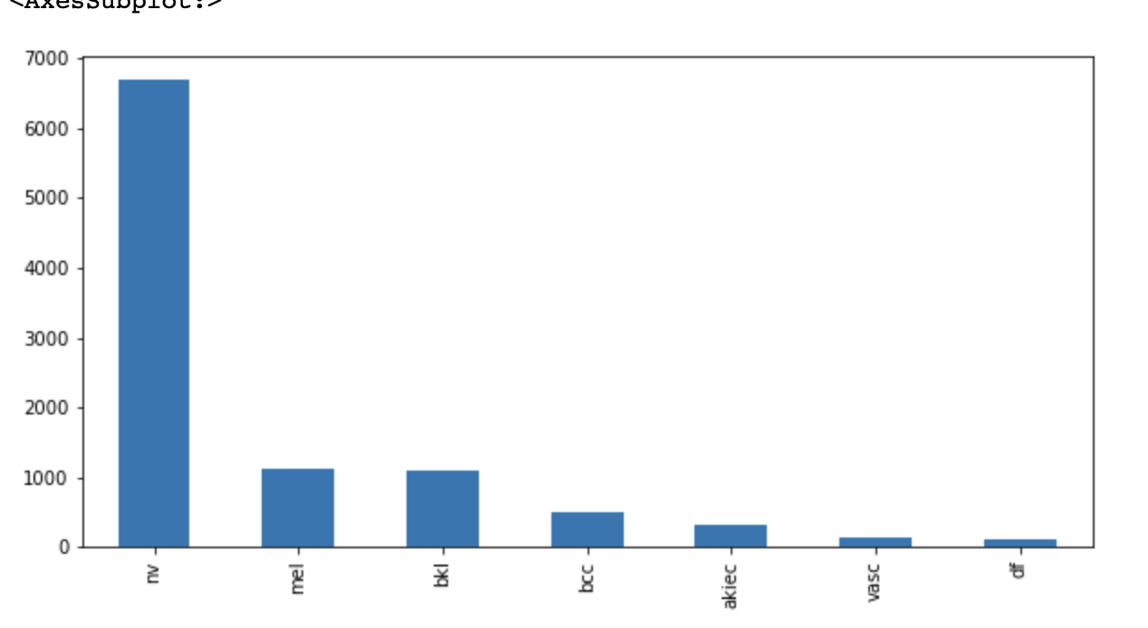
Types of Skin Diseases
Skin Diseases | Pathology
nv (Melanocyte nevi ) | Non-Cancerous
Bkl (Sebohrreic keratosis) | Non-Cancerous
Df (Dermatofibrom) | Benign Tumors (Non Cancerous)
Vasc (Non-Cancer Vascular Lesions) | Non-Cancerous Pyogenic Granulomas
Bcc (Basal Cell Carcinoma) | Cancerous
Mel ( Melanoma ) | Cancerous (Malignant)
Akiec (Actinic Keratosis) | Cancerous

Slide 16
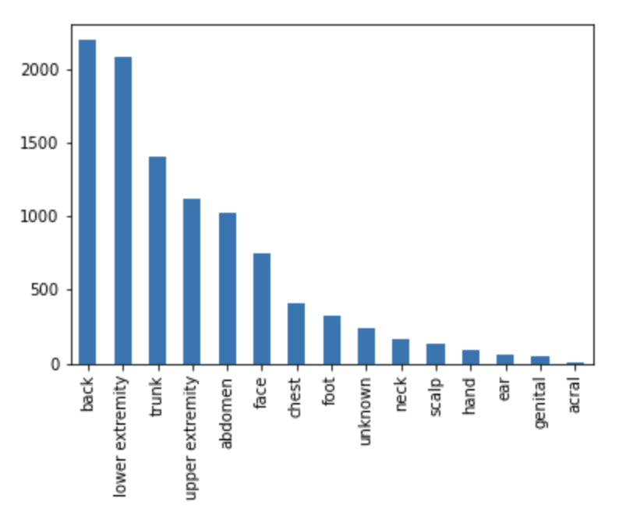
Skin Lesion Localizations

Slide 17
Models Performance

Slide 18
Classification Models (7 Classes)
Models Name | Accuracy Train | Accuracy Validation
Baseline ( AdaBoost ) | 0.65 | 0.66
Kneighbors Model | 0.66 | 0.66
XGBClassifier | 0.67 | 0.69
Best Model | Accuracy Test
XGBClassifier | 0.66

Slide 19
Classification Models (2 Classes)
Models Name | Accuracy Train | Accuracy Validation
Baseline ( AdaBoost ) | 0.80 | 0.792
Kneighbors Model | 0.63 | 0.67
XGBClassifier | 0.8 | 0.797
Best Model | Accuracy Test
XGBClassifier | 0.81

Slide 20
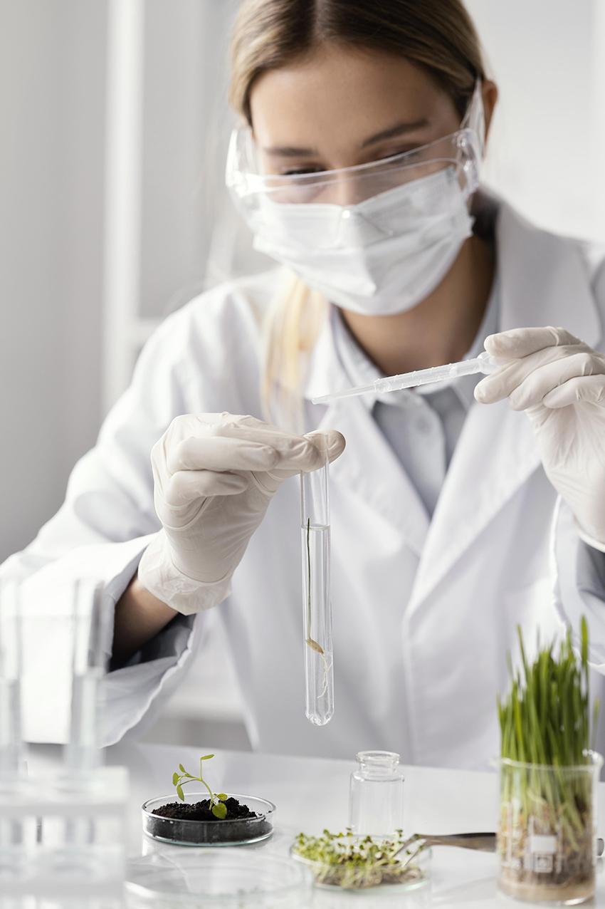
Neural net (NN) Vs Convoluted Neural net (CNN) ( 7 Classes)
Type | NN |  | CNN
Accuracy | Accuracy Train | Accuracy Validation | Accuracy Train | Accuracy Validation
Simple | 0.64 | 0.66 | 0.66 | 0.69
Medium | 0.66 | 0.69 | 0.66 | 0.69
Complex | 0.66 | 0.69 | 0.67 | 0.69
Best Model | Accuracy Test
Complex (CNN) | 0.69

Slide 21
Neural net (NN) Vs Convoluted Neural net (CNN) ( 2 Classes)
Type | NN |  | CNN
Accuracy | Accuracy Train | Accuracy Validation | Accuracy Train | Accuracy Validation
Simple | 0.80 | 0.83 | 0.80 | 0.83
Medium | 0.80 | 0.83 | 0.79 | 0.83
Complex | 0.80 | 0.83 | 0.80 | 0.83
Best Model | Accuracy Test
Complex (CNN) | 0.79

Slide 22
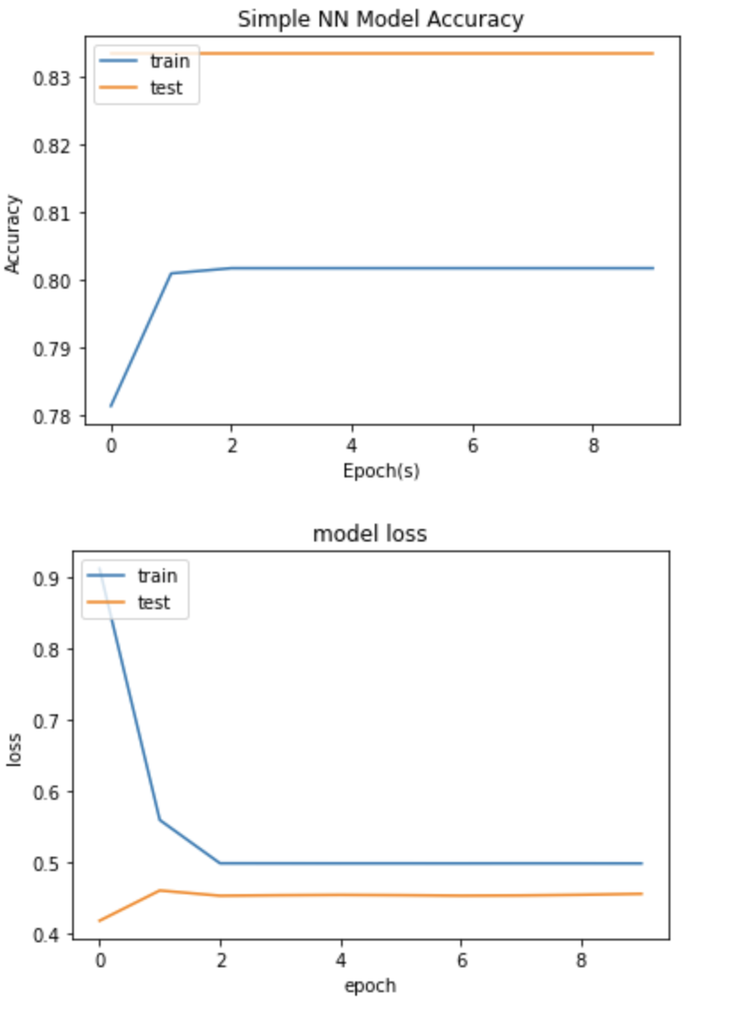
Simple NN Model
This Char Between Accuracy And Epoch (s)
This Char Between Loss And Epoch

Slide 23
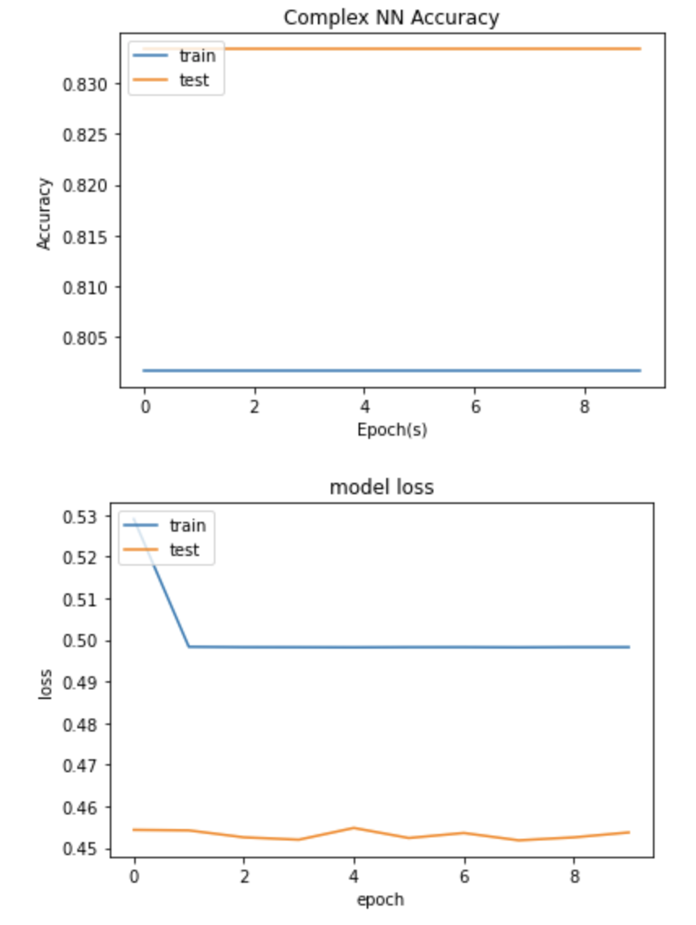
Medium NN Model
This Char Between Accuracy And Epoch (s)
This Char Between Loss And Epoch

Slide 24
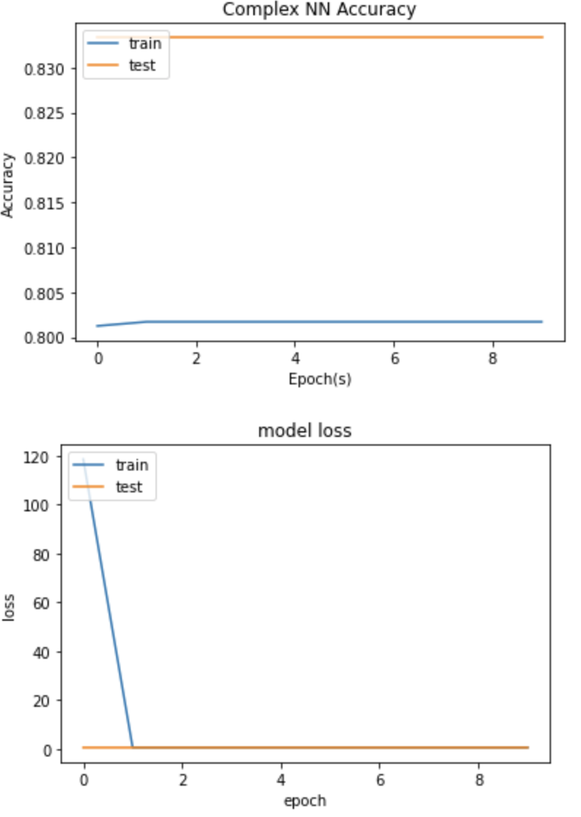
Complex NN Model
This Char Between Accuracy And Epoch (s)
This Char Between Loss And Epoch

Slide 25
Visualizing Simple Convoluted NN (CNN Model)

Slide 26
Visualizing Complex Convoluted NN (CNN Model)

Slide 27
Transfer Learning (7 Classes)
Pretrained | Accuracy Train | Accuracy Validation
ResNet152 | 0.663 | 0.693
EfficientNet | 0.660 | 0. 690
VGG16 | 0.661 | 0. 691
VGG19 | 0.661 | 0. 692
DenseNet | 0.661 | 0.693
Best Transfer Learning Model | Accuracy Test
ResNet152 | 0.65

Slide 28
Transfer Learning (2 Classes)
Pretrained | Accuracy Train | Accuracy Validation
ResNet152 | 0.8014 | 0.833
EfficientNet | 0.8014 | 0.833
VGG16 | 0.8000 | 0.833
VGG19 | 0.8000 | 0.833
DenseNet | 0.8014 | 0.833
Best Transfer Learning Model | Accuracy Test
ResNet152 | 0.80

Slide 29
Solutions for increasing Accuracy
Using Batch Normalization Layer
Using different optimizers with different learning rates
Increased initial optimizer learning rate 0.05
Using ReduceLROnPlateau by factor of 0.2
Change in batch size

Slide 30
Overfit solutions
Using L1-L2 kernel Regularizers
Using EarlyStopping Callback
Dropout Layers (%50, 30%, 20%)

Slide 31
Future Work
This project could be extended further to diagnose skin cancer lesions at early stages to guide precision treatment as early as possible through feeding more high-resolution images and utilizing dimensionality reduction techniques in the deep learning pipeline.

Slide 32
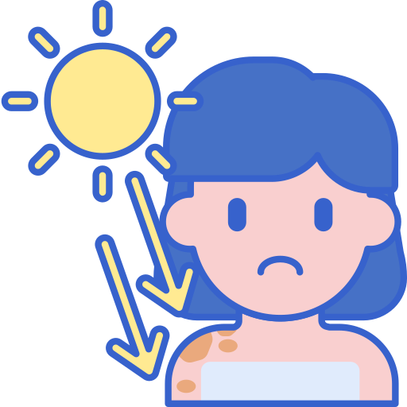
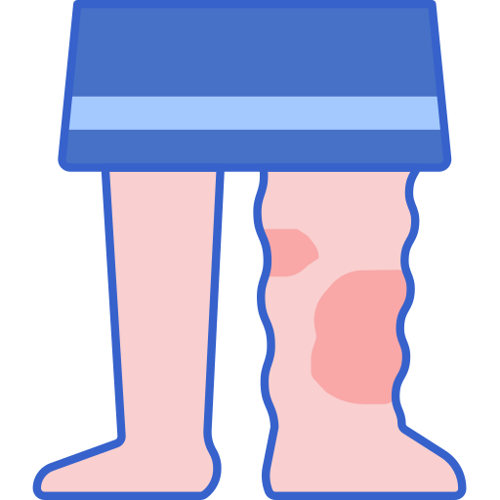
THANKS For Listening

